Slide 1
Lecture 3
Self-exploration as the Process for Value Education

Slide 2
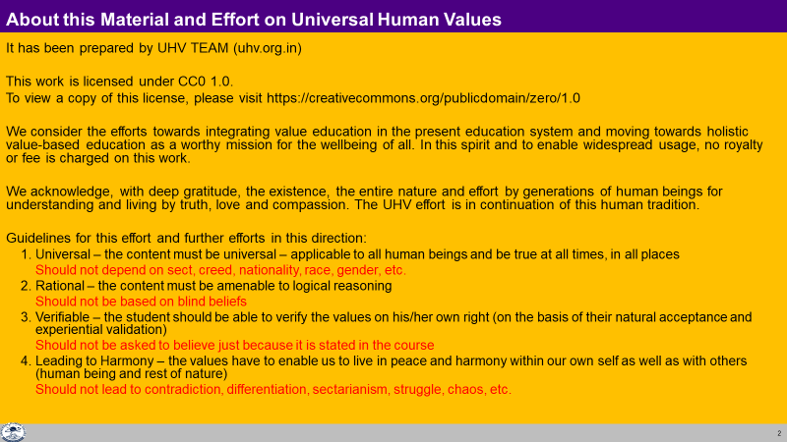

Slide 3
Process
Whatever is said is a Proposal
Verify it on Your Own Right – on the basis of our Natural Acceptance
(Do not assume it to be true or false)
It is a process of Dialogue
A dialogue between me and you, to start with
It soon becomes a dialogue within your own self
between what you are and what you really want to be (your natural acceptance)
The purpose of this workshop is to initiate/strengthen this internal dialogue
izLrko gS
tk¡pas & Lo;a ds vf/kdkj ijAviuh lgt LohÑfr ds vk/kkj ijA
¼ekuas ugha½
;g laokn dh izfØ;k gSA
;g laokn vkids vkSj esjs chp 'kq: gksrk gS] fQj vki eas pyus yxrk gSA
More

Slide 4
What is this Workshop / Course ;g f'kfOkj D;k gS
It is a process of dialogue – between me and you, to begin with
;g laokn dh izfØ;k gSA ;g laokn vkids vkSj esjs chp 'kq: gksrk gSA
2. It soon becomes a dialogue within your own Self…
“kh?kz gh ;g laokn vkids Lo;a eas pyus yxrk gSA

Slide 5
The Dialogue Within
1. We have to discover our natural acceptance
(where I want to reach)
What I Really Want to Be
My Natural Acceptance
My Intention
Always
Relationship
3. We have to ensure this dialog and ensure harmony within
(evaluate your desires vis-à-vis your natural acceptance)
These are in Contradiction
Unhappiness
These are in Harmony
Happiness
Dialogue
2. We have to find out what we are
(where I am now)
What I am
My Desire, Thought, Expectation…
My Competence
Sometimes
Opposition
Sometimes
Relationship

Slide 6
Points for Self-observation
We have the innate potential to recognise what is right
We are endowed with natural acceptance
It is innate, a part and parcel of our being
It is invariant, uncorrupted by pre-conditioning
It is definite
As we refer to our natural acceptance, we become self-referential
(self-organised, autonomous, swatantra)

Slide 7
Process of Self-exploration, Self-investigation
It is a process of dialogue – between me and you, to begin with. It soon becomes a dialogue within your own self
It is a process of dialogue between what I am (tSlk eSa g¡w) and my Natural Acceptance or what I really want to be (tSlk gksuk eq>s lgt Lohdk;Z gS = LoRo)
It is a process of Self-exploration, Self-investigation → Self-evolution
It is a process of knowing oneself and through the self, knowing Nature and the entire existence
It is a process of recognizing one's relationship with every unit in nature/existence; and fulfilling that relationship
It is a process of knowing Human Conduct (ekuoh; vkpj.k) and living according to it
It is a process of living in harmony within, living in harmony with others…living in harmony with entire existence

Slide 8
v/;;u izfdz;k
1- ;g ,d Lkaokn dh izfdz;k gSA
2- ;g Lo;a ¼tSlk eSa gw¡½ dh vius LoRo ¼tSlk gksuk eq>s lgt Lohdk;Z gS½ ls laokn dh izfdz;k gSA
3- ;g Lo;a esa] Lo;a ds vf/kdkj ij tk¡pus dh izfdz;k gSA
4- ;g Lo;a dks ,oa Lo;a ds ek/;e ls laiw.kZ vfLrRo dks le>us dh izfdz;k gSA
5- ;g vfLRkRo dh gj bdkbZ ds lkFk vius laca/k dks igpkuus ,oa rnuqlkj thus dh izfdz;k gSA
6- ;g ekuoh; vkpj.k dks le>us ,oa rnuqlkj thus dh izfdz;k gSA
7- ;g Lo;a esa Lora=rk ,oa lexz vfLrRo ds lkFk LojkT;iwoZd thus dh izfdz;k gSA
LoRo Lrra=rk LojkT;

Slide 9
Scope of this Workshop / Course: Self-evolution, Self-extension
Knowing your Natural Acceptance
What you really want to be
Natural Acceptance Swatva LoRo
Living in accordance with your Natural Acceptance
Living in harmony within
Self-organized Swatantrata Lora=rk
Living in harmony with others… with the entire existence
Self-extension Swrajya LojkT;
Harmony Everywhere = Universal Order

Slide 10
शिविर का आशय
viuh lgt Lohd`fr dks ns[kuk@le>uk
tSlk gksuk eq>s lgt Lohdk;Z gS
LoRo
lgt Lohd`fr ds vk/kkj ij Hkko] fopkj
Lo;a esa O;oLFkkiwoZd thuk
Lora=rk
nwljksa ds lkFk laca/k@O;oLFkkiwoZd thuk & laiw.kZ vfLrRo ds lkFk
LojkT;

Slide 11
Self-exploration, Self-investigation
1. Content of Self Exploration:
  a. Desire (pkguk) - Aim, Objective, Purpose
What do I want to achieve?
  b. Program (djuk) – Process of achieving the desire, action
How do I achieve it ?
2. Process of Self Exploration
a. Whatever is stated is a Proposal
Verify it on your own right
Do not assume it to be true/ false
b. Self-verification
Happiness, Prosperity
Continuity

Slide 12
Content of Self-exploration
Desire-
Happiness
Prosperity
The continuity of Happiness and Prosperity
Let us find out:
  Do we desire for Happiness?
  Do we desire for Prosperity?
  Do we desire for the continuity of both (happiness & prosperity)?
  If continuity of happiness and prosperity is ensured then what else would you desire?
  Our desires are not unlimited or indefinite
  Our basic aspiration is for happiness, prosperity and its continuity

Slide 13
Process of Self-Exploration
Whatever is stated is a Proposal
Verify it on your own right (Do not assume it to be true/ false)
Proposal
1
2
Verify
on the basis
Of
your
Natural
Acceptance
Experiential Validation
Live according to it
2a
2b
Behaviour with
Human Beings
Work with
Rest of Nature
Mutual Happiness
Mutual Prosperity
Which process is Naturally Acceptable to you?
A process of self-exploration, self-verification on your own right, leading to understanding in yourself
or
A process of do’s & don’ts, in which you assume what is said, without verification
RIGHT
UNDERSTANDING

Slide 14
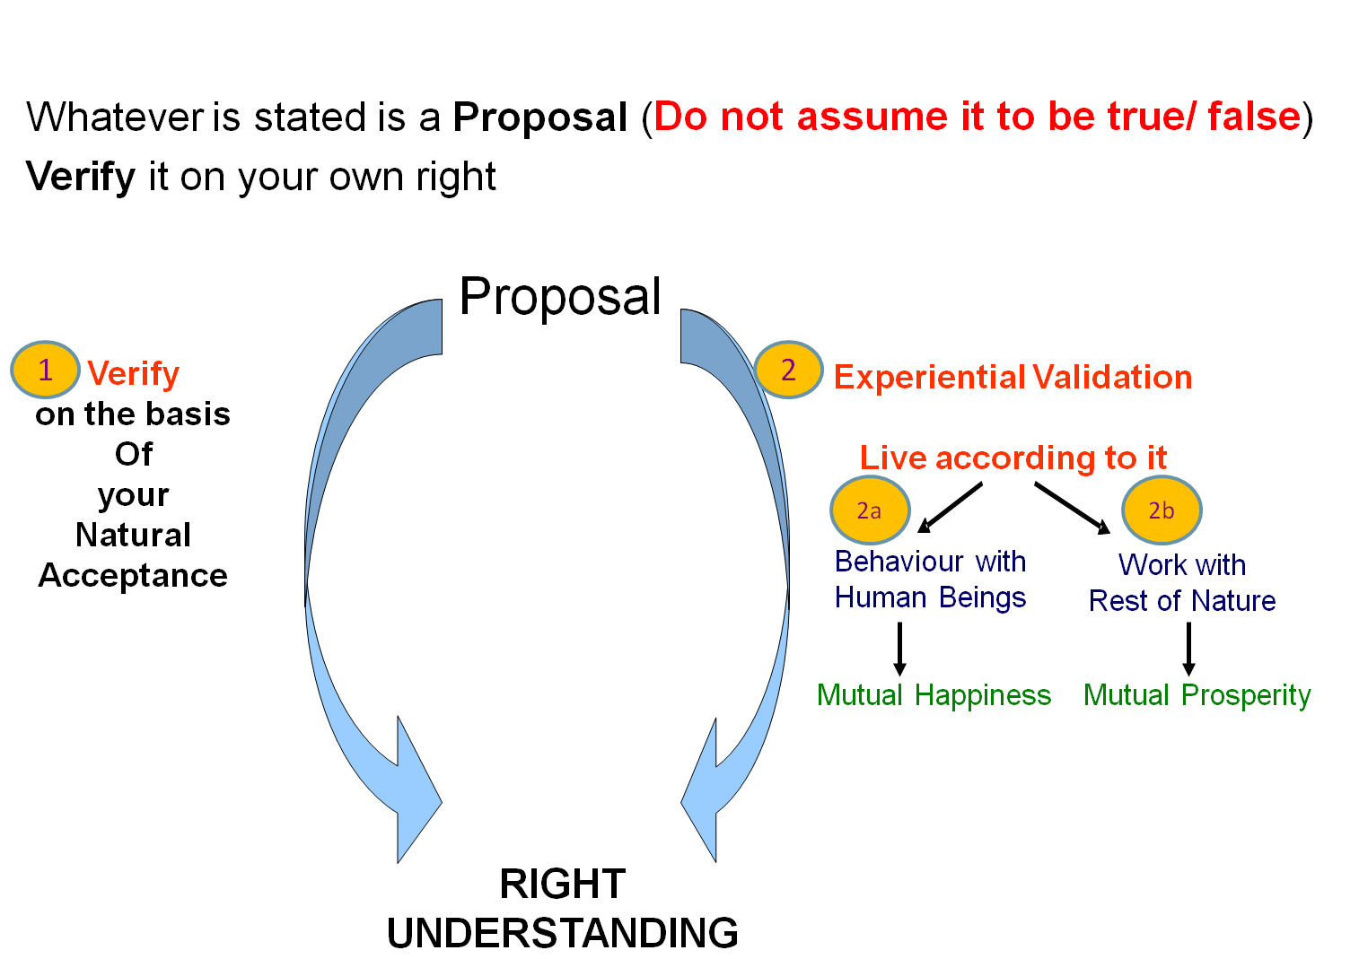
Sum Up- Self-exploration
Content of self-exploration = Basic human desire
= Happiness, prosperity → continuity
Process of self-exploration
= Self-investigation, self-verification
It is a process of
living in harmony within,
living in harmony with others…
and ultimately,
living in harmony with the entire existence
The Purpose of this workshop/course is to initiate/strengthen self-exploration in you

Slide 15
Key Points
Self-exploration as the Process for Value Education

Slide 16
Process
Whatever is said is a Proposal
Verify it on Your Own Right – on the basis of our Natural Acceptance
(Do not assume it to be true or false)
It is a process of Dialogue
A dialogue between me and you, to start with
It soon becomes a dialogue within your own self
between what you are and what you really want to be (your natural acceptance)
The purpose of this workshop is to initiate/strengthen this internal dialogue
izLrko gS
tk¡pas & Lo;a ds vf/kdkj ijAviuh lgt LohÑfr ds vk/kkj ijA
¼ekuas ugha½
;g laokn dh izfØ;k gSA
;g laokn vkids vkSj esjs chp 'kq: gksrk gS] fQj vki eas pyus yxrk gSA
More

Slide 17
The Dialogue Within
1. We have to discover our natural acceptance
(where we want to reach)
What I Really Want to Be
My Natural Acceptance
My Intention
Always
Relationship
3. We have to ensure this dialog and ensure harmony within
(evaluate our desires vis-à-vis our natural acceptance)
These are in Contradiction
Unhappiness
These are in Harmony
Happiness
Dialogue
2. We have to find out what I am
(where we are now)
What I am
My Desire, Thought, Expectation…
My Competence
Sometimes
Opposition
Sometimes
Relationship

Slide 18
Self-exploration, Self-investigation
1. Content of Self Exploration:
  a. Desire (pkguk) - Aim, Objective, Purpose
What do I want to achieve?
  b. Program (djuk) – Process of achieving the desire, action
How do I achieve it ?
2. Process of Self Exploration
a. Whatever is stated is a Proposal
Do not assume it to be true/ false
Verify it on your own right
b. Self-verification
Happiness, Prosperity
Continuity

Slide 19
Process of Self-verification
Whatever is stated is a Proposal (Do not assume it to be true/ false)
Verify it on your own right
Proposal
1
2
Verify
on the basis
Of
your
Natural
Acceptance
Experiential Validation
Live according to it
2a
2b
Behaviour with
Human Beings
Work with
Rest of Nature
Mutual Happiness
Mutual Prosperity
Which process is Naturally Acceptable to you?
A process of self-exploration, self-verification on your own right, leading to understanding in yourself
or
A process of do’s & don’ts, in which you assume what is said, without verification
RIGHT
UNDERSTANDING

Slide 20
FAQs for Lecture 2
Self-exploration as the Process for Value Education

Slide 21
Question(s) 1: Natural Acceptance Response
What is natural acceptance?
How can we say that NA is invariant with time?
How can everyone’s Natural Acceptance be same? e.g - One likes waking up early in the morning while the other likes to wake up late. Additionally, doesn’t Natural Acceptance change with time and situation? e.g. - when I was a kid, I used to like playing with toys but now I like to visit places around the world.
Natural acceptance is what I accept innately. For example, ask yourself: what is naturally acceptable, the feeling of relationship or opposition? Now see from where you get the answer.
In the previous example, just find out if the response changes with time or remains the same. What would be your answer in your childhood, as an adult, as an old person?
We need to distinguish between natural acceptance and liking. Liking can vary from person to person, but not the natural acceptance. A person who wakes up late or early, both naturally accept to be healthy. Whether you like to play with toys or visit the world, you naturally accept to be happy.

Slide 22
Natural Acceptance Example
Namaste Namaste Feeling of relationship, respect…
With bowed with bare
Head and feet
Bare feet
Naturally acceptable innate, invariant, universal… Leads to harmony
uncorrupted by preconditioning… Happiness in Self
Namaste Namaste Feeling of opposition, disrespect… Disharmony in Self
With bowed with bare
Head and feet
Bare feet Not naturally acceptable Unhappiness in Self
Expression Feeling
Creativity, Variation May be definite (if based on NA)
or indefinite (if based on assumption)
Can not check this part Can check only this part with your natural acceptance
with your natural acceptance

Slide 23
Natural Acceptance Examples
Rice from Rice Food Nurturing the Body Feeling Harmony in the Body
A specific of Self
Restaurant Regulation
Rice from Rice Food Tasty to Self ? ?
A specific (and not sure if
Restaurant nurturing)
When it comes to the details of how to fulfill this relationship, this role, we have to get the necessary details through observation, analysis or through some other source- human beings or written documents, these details may have varieties, different possibilities, Therefore, there is variety, different possibilities , when it comes to how this role can be fulfilled, e.g. details of how to ensure nurturing of the body
Natural Acceptance has to do with what is my relationship to the reality of concern.
e.g. my body- do I want to nurture or harm my body.
It has to do with my purpose, my role in different levels of human existence.
This role, this purpose in relationship is definite.
Hence, Natural Acceptance is definite,
e.g. Natural acceptance for nurturing of the body

Slide 24
Natural Acceptance Examples
Exam Self-empl Live by it Understand all Harmony in the Self
that is taught…
Job Exam Cheating Remember for exam ?
When it comes to the details of how to fulfill this relationship, this role, we have to get the necessary details through observation, analysis or through some other source- human beings or written documents, these details may have varieties, different possibilities, Therefore, there is variety, different possibilities , when it comes to how this role can be fulfilled, e.g. details of how to ensure nurturing of the body
Natural Acceptance has to do with what is my relationship to the reality of concern.
e.g. my body- do I want to nurture or harm my body.
It has to do with my purpose, my role in different levels of human existence.
This role, this purpose in relationship is definite.
Hence, Natural Acceptance is definite,
e.g. Natural acceptance for nurturing of the body

Slide 25
Question(s) 2: Natural Acceptance Response
Is Natural Acceptance universal for all human being across people of all countries, religion, caste, creed, gender, age, rich-poor, etc.?
What we accept is something quite subjective, different things appeal to different people – How can we say that natural acceptance is same for everybody? Actually what is this natural acceptance?
Is Natural Acceptance the same as inner conscience?
Yes. But you can keep it open and verify. We have interacted with thousands of people from all sorts of background, and found it to be the same for all.
As mentioned earlier, we need to distinguish between natural acceptance and acceptance or liking or appeal etc. You will see that Natural Acceptance is
Innate to me
Invariant with time and place i.e. Universal
Liking or appeal has to do with details of how to fulfill relationship, which may have variety,
Yes. We may relate it to conscience, inner voice, pure observer…

Slide 26
Question(s) 3: Natural Acceptance Response
Natural acceptance is innate, invariant and universal.
Acceptance is what I assume to hold good in given situation.
Forced acceptance is what I do not accept, but in given situation, I am forced to compromise, abide by it.
Social norms and family traditions are basically the details worked out at some particular time and situation about how to fulfill the purpose, the goal set by the society.
Therefore, we need to verify, from time to time-
Whether the goals set are correct- through natural acceptance
Whether these norms and traditions are able to meet those goals in the present time and situation
What is difference between natural acceptance, acceptance, and forced acceptance?
We have to follow social norms and live as per family traditions to be accepted in the society, or even in the family. This has been working for a long time. Do we need to verify these norms and traditions also?

Slide 27
Question(s) 4: Right Understanding Response
What is right understanding? How to know whether my understanding is right or wrong?
Is it same as natural acceptance?
Everyone is right according to his or her own understanding. Kindly comment.
There is nothing absolute in this world. So, how can we talk about such things with such absoluteness?
If I understand rightly, it will be:
  a. Satisfying to me,
  b. Invariant with time and place
  c. Universal for all human beings
  d. Leading to harmony in my living, in behaviour with human beings, and work with the rest of nature
  e. I will naturally accept to continue with it.
One may assume oneself to be right. But we need to verify our assumptions on the basis of above criteria to see if it is part of (or based on) right understanding.
On a lighter note- is this statement absolute!.
As far as the purpose, goal is concerned, they are definite and universal. Details of their fulfillment may have variety, as mentioned above, e.g. Nurturing of the body

Slide 28
Differentiate between
Understanding something and thinking about it (thought)
Feeling
(Definite, objective…)
Expression (thought, expectation, beh, wk)
(Variety, subjective…)

Slide 29
Question(s) 5: Self-exploration Response
How is it possible to understand everything by the self and through the self? Just being aware of “what I am” and “what I really want to be” itself is so difficult.
As you gradually observe, you will see that the essence of the whole existence, the co-existence (relationship, harmony and co-existence), is reflected in me. And I can observe it.
Presently, being aware of “what I am” and “what I really want to be” may appear difficult. But as you go on exploring, the clarity that you get in the process (leading towards a harmonious self), becomes self-motivating for you.

Slide 30
Question(s) 6: Self-exploration Response
What is the need for self-exploration? The existence is so vast and I am a tiny unit of this existence. Is it not unwise to also even think of exploring everything on my own right?
What is wrong in assuming something written in the books as true? Why to verify everything?
The existence is vast, but the content to explore is very simple. You need not verify about every incident taking place in this existence, rather only the essence of this existence- i.e. relationship, harmony and co-existence (material and consciousness units in space).
Secondly, unless you verify on your own right, how do you make to a program to live with it in a mutually fulfilling manner, be it the other human being or any other unit of nature?
What is written in the books is likely to be true. But how do I understand the true meaning of the words in the books unless I observe the reality indicated by myself? To be certain, I need to explore myself and understand. This is what any authentic book will expect us to do.

Slide 31
In each and every Self, there is naturally
- the need to know (to understand the entire existential reality)
Potential to know (to explore, pay attention, see, understand) the essence

Slide 32
Question(s) 7: Self-exploration Response
What if in my experiential validation, the proposal is ensuring happiness with one person but not with the other? How do I validate it?
What is meant by mutual prosperity with the rest of nature?
You can see for yourself that your happiness is ensured the moment you have the natural feeling, e.g. feeling of respect; when you express this feeling and the other person receives this natural feeling of respect, he is in a state of harmony and happiness within. However, there may be some problem in your expression or in the reception of the other person, that has to be rectified, and that takes time.
Mutual prosperity means that when I am interacting with the nature, I get the feeling of prosperity within me, and the nature gets enriched, preserved in the process.

Slide 33
Question(s) 8: Swatantrata Response
Isn’t swatantrata (self-organised) and freedom the same? (please give examples of swatantrata at each level of being – individual, family, society and nature)
Swatantrata is being self-organized. At every level, understanding and living in harmony is the self-organized state.
Generally speaking, freedom is to be able to make a selection without any external pressure.
Freedom may or may not be leading to a self-organized state as one may try to be free of external pressure but succumb to internal pressure, of sensations or pre-conditionings.
There are two kinds of freedom: freedom ‘from’ and freedom ‘to’.
Many times when we talk of freedom, we are talking of ‘freedom from’ some external pressure.
When we have to decide the program with ‘freedom to’ do something, we need right understanding to make a definite program for happiness.

